Slide 1
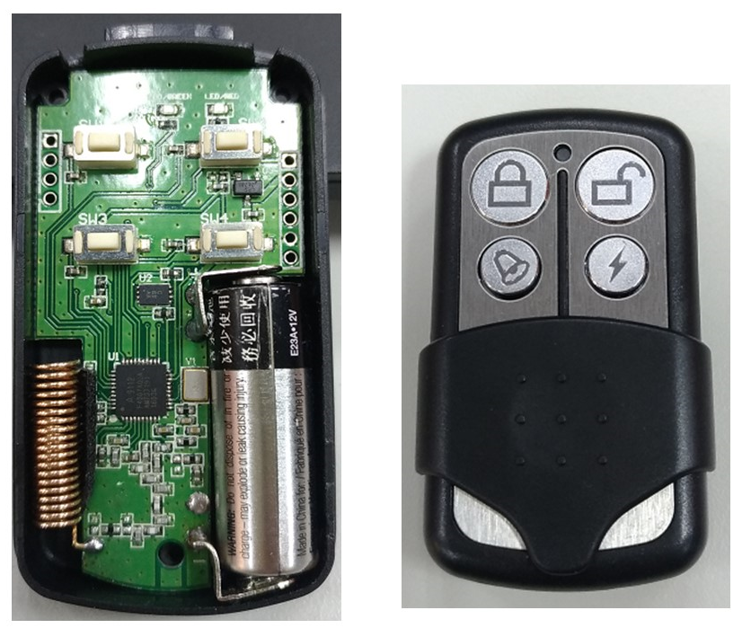
Authentication
Remote
Control
Solution
Marten Huang

Slide 2
新式（強密碼）遙控器
使用 Crypto IC 的特點
國際晶片大廠 Microchip (ATMEL) 的品質技術保證
使用完全隨機產生動態碼加上SHA-256演算法，取代滾碼技術
系統安全等級及金鑰長度均為 256位元，遠高滾碼長度
裝置間雙向身份認證技術 (Authentication)
遙控器在坊間無法被複製，唯有遙控器廠商能再生產製造
沒有掉碼、需要重新配對的問題
線路精簡，提供完整的設計參考方案
提昇產品安全性、產品競爭力，創造利潤空間

Slide 3

Block Diagram
FOB (User)
HOST (Door)
Sub-GHz
315
433/470
868
915
Button
RF MCU
RF MCU
Crypto
LED
EEPROM
Crypto
Button
Buzzer
LED
RF MCU: Amiccom A9112
Crypto: ATMEL ATSHA204
EEPROM: Microchip 24AA16

Slide 4
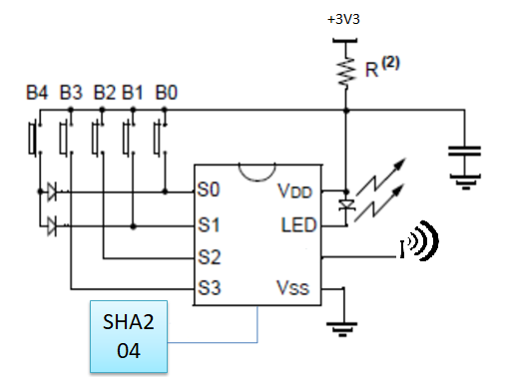
FOB Transceiver
USD1
RF Transceiver (Include 8051)
Amiccom A9112/A9129
Freq. 315/433/470/868/915Mhz
16KB Flash, 4KB SRAM
UART, I2C, SPI
PWM x 2
ADC x 8
Crypto IC (I2C)
Atmel ATSHA204
Unique S/N
SHA-256
TRNG, OTP

Slide 5
Crypto IC: ATSHA204
We use functions on ATSHA204
Device Unique Serial Number 72bits
Key Slot for Customer or Product KEY
32Bytes Random Number Generator (TRNG)
Standard SHA-256 Engine
Why ATSHA204A
The Unique SN is different with other FOBs
The secret Key in ATSHA204A can’t be copied
The ATSHA204A can avoid reverse engineering
High-quality Random Number Generator

Slide 6
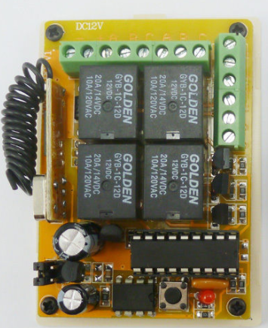
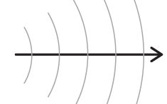
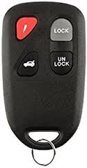
Handshaking
R1: Send Identify
Send Device_Sn to “Door”
--------------------------------------------------------→
D1: Verify Device_Sn in the device list
D2: Generate a challenge RND(#) to “Remote”
←------------------------------------------------------------------------
R2: ANSWER the challenge and CMD to Door
--------------------------------------------------------→
D3: Check the ANSWER, if it is right, execute the CMD

Slide 7
Calculate the ANSWER
ANSWER is a result of SHA2 result (256bits)
There are three input parameters
Unique serial number in ATSHA204
Random number
Product key
Unique SN + Product_Key
SHA-256
Random #
ANSWER

Slide 8
Resources

Slide 9

Project Resources
HW Design Files
SCH, PCB, BOM, Datasheet
A9112 US$0.7 + ATASHA204A US$0.3
Github
A9112 MCU reference code (Host & FOB)
YouTube
Introduce video (But in Chinese)

Slide 10
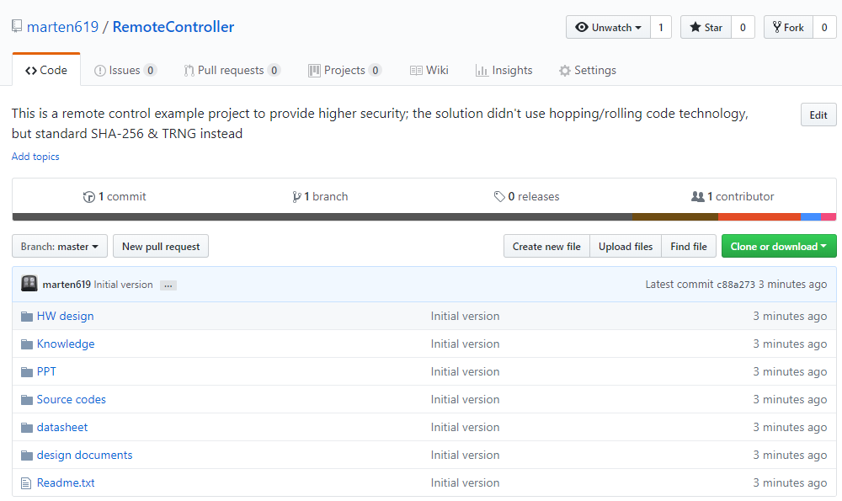
Open Source - Github
https://github.com/marten619/RemoteController

Slide 11
YouTube Video
Compare with Hopping Code
https://youtu.be/E1CEQ3T0k3I
Authentication Remote Control Introduction
https://youtu.be/AgV3q36lbQA
Resources & Improvements
https://youtu.be/4fpW_bkqgPE

Slide 12
More Improvements

Slide 13
Improvements
Send Link_ID instead crypto’s unique id when FOB initial connection with Host
When pairing, Host remember FOB’s unique id then keep it into EEPROM; the id is from Crypto IC. For better security, Host can random generate a Link_ID for each FOB instead using crypto unique id. But FOB need to consider how to keep Link_ID when power down. EEPROM may add cost.

Slide 14
Improvements
Unidirectional flow mode from FOB to Host
The Host question FOB every time by sending a big random number, once FOB answer is correct; Host doesn’t question FOB anymore before DownCounter decrese to 0; Instead the new question can be last random number + DownCounter.
Example:
If FOB want to open door, just send “DownCounter & Answer” to Host. Host need to use RND# and DownCounter as input parameters to verify the Answer from FOB. When the answer is right, do open the door.
Host must verify DownCounter is decreased every time and provide a new question (RND#) if DownCounter become 0

Slide 15
Improvements
Automatically channel change
RF MCU can support channel slot change in SW. you can implement an algorithm to avoid channel conflicts

Slide 16
Crypto IC Datasheet

Slide 17
ATSHA204 Features
Cost-effective Symmetric Authentication Solution (Fast Authentication)
Secure Symmetric Authentication Device Host and Client Operations
Easy Key Management
Crypto Element with Protected Hardware-based Key Storage
Best suited for counterfeit prevention
Superior SHA-256 Hash Algorithm with Message Authentication Code (MAC)
Best-in-class, 256-bit Key Length; Storage for Up to 16 Keys
Guaranteed Unique 72-bit Serial Number
Internal, High-quality Random Number Generator (RNG)
4.5Kb EEPROM for Keys and Data, includes 512 bit OTP (One Time Programmable) Bits for Fixed
1MHz I2C Interface & Single-Wire Interface
Message Security
Anti-Cloning

Slide 18
ATSHA204 Package

Slide 19
ATSHA204 DC Parameters

